Slide 1
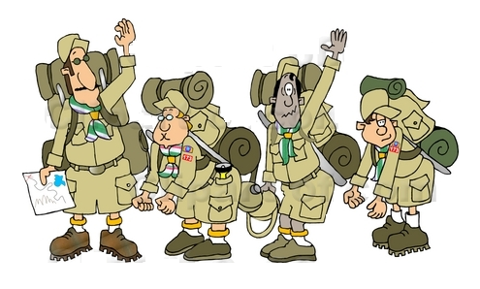
UNIT SUCCESSION PLANNING
PACK, TROOP AND CREW
PLANNING FOR SUCCESS!

Slide 2

WHO’S NEXT?
WILL YOUR UNIT SURVIVE YOUR DEPARTURE?
SUCCESSION PLANNING:
WHAT, WHY,
WHO, WHEN, & HOW

Slide 3

UNIT SUCCESSION
PLANNING BASICS
WHAT IS SUCCESSION PLANNING?
WHY SHOULD A UNIT CONDUCT IT?
WHO ARE YOUR NEXT LEADERS?
WHEN SHOULD UNIT PLAN?
HOW DO YOU DO SUCCESSION PLANNING?

Slide 4

WHAT IS SUCCESSION PLANNING
AN ORGANIZED APPROACH TO FINDING YOUR OWN REPLACEMENT AND REPLACEMENTS FOR OTHER UNIT LEADERS

Slide 5

WHY PLAN FOR SUCCESSION?
DO YOU PLAN TO BE AT THIS UNIT FOREVER?
IS THE UNIT WORTH SAVING?
WOULD YOU LIKE A LITTLE HELP?
IF YOU LEFT TOWN TODAY, WHO WILL MAKE SURE THE BOYS AREN’T DISAPPOINTED?
IF NO ONE CAN DO IT AS WELL AS YOU, MAYBE YOU SHOULD TRAIN YOUR SUCCESSOR?

Slide 6

WHEN TO PLAN FOR SUCCESSION?
TODAY!
EXECUTION OF YOUR SUCCESSION PLAN BEGINS WHEN NEW PARENTS ATTEND NEW PARENTS ORIENTATION
YOU WORK YOUR SUCCESSION PLAN AT EVERY MEETING
YOU ADJUST YOUR SUCCESSION PLAN WHENEVER THINGS CHANGE
NEW PARENTS ARE NEW OPPORTUNITIES

Slide 7

WHO ARE YOUR POTENTIAL SUCCESSORS?
EVERY NEW PARENT THAT JOINS YOUR UNIT IS A POSSIBLE SUCCESSOR
TREAT THEM ACCORDINGLY
ENSURE THEY ARE WELCOME
ENSURE THEY ARE FULLY INTEGRATED
ENSURE THEY KNOW HOW THE UNIT WORKS
KEEP TRACK OF YOUR REPLACEMENT

Slide 8


HOW DO YOU DO
SUCCESSION PLANNING?
HAVE A LEADERSHIP SUCCESSION PLAN
IDENTIFY AND LIST ALL KEY UNIT POSITIONS
SURVEY INCUMBENTS AND LEARN THEIR PLAN
PLAN TO HAVE TWO VICES TO LEARN AND SHADOW
HAVE A LEADERSHIP/TALENT SELECTION TEAM
MEET WITH THE PROSPECT
INVITE THE PROSPECT TO FILL THE POSITION
TRAIN, TRAIN, TRAIN

Slide 9
SUCCESSION PLANNING RESOURCES
http://www.hoac-bsa.org/ideal-year-of-scouting
http://www.scouting.org/scoutsource/Media/Relationships/TrainingtheCOR/05.aspx
Selecting Cub Scout Leadership, No. 13-500; Selecting Quality Leaders, No. 18-981

